Slide 1

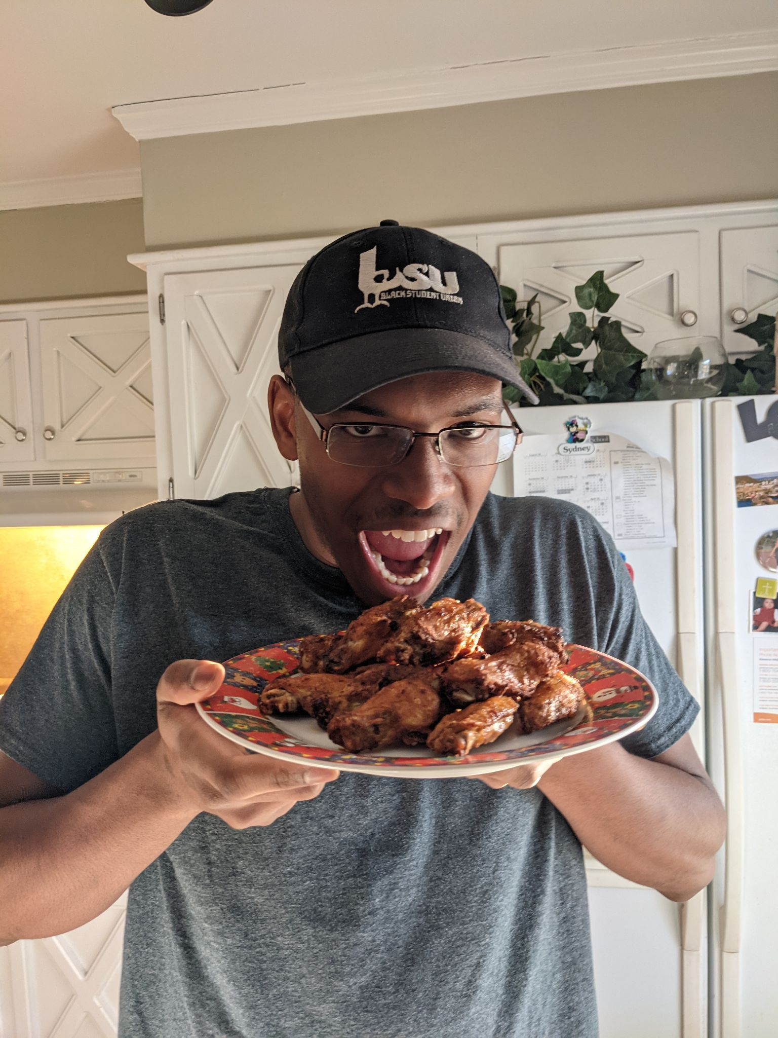
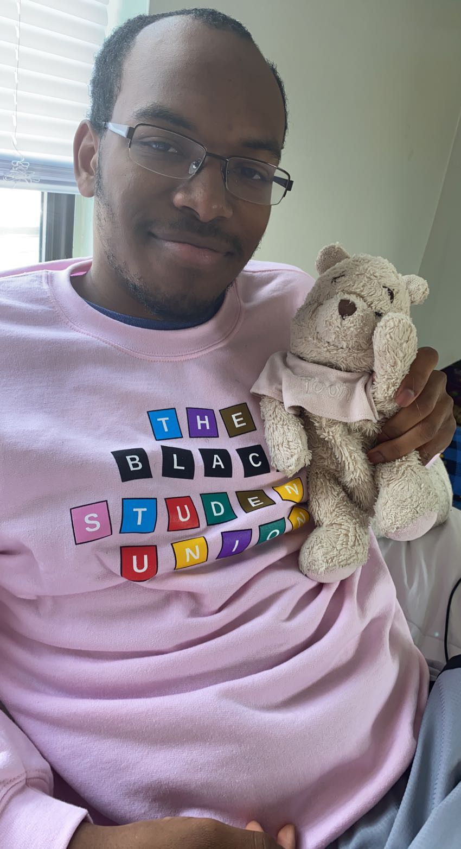
Thomas Vance
Majors: Political Science and Afro-American and African Studies
Speaker of the Black Student Union
Big Air Fryer and Bike Ride Guy

Slide 2
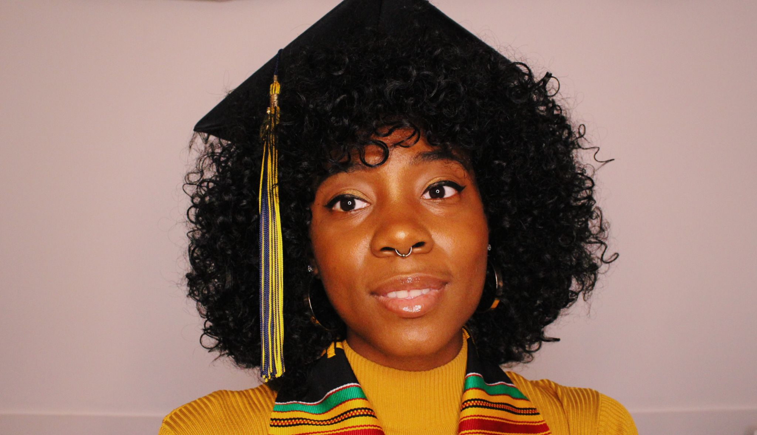
Danielle Williams
Majors: Afroamerican and African Studies and Film Television and Media
Detroit Native
YouTube Channel: Definitely Not Dani
Aspiring Alkaline Vegan

Slide 3
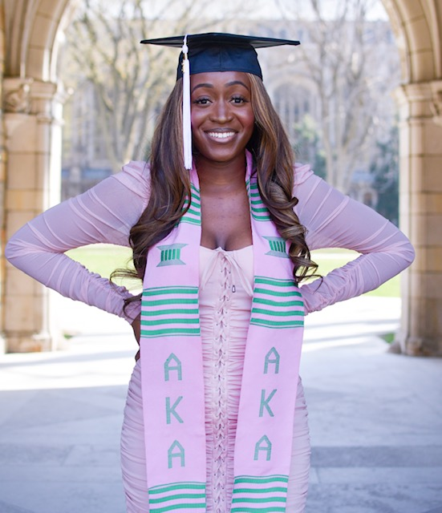
Selina Asamoah
Majors: International Studies, Minor Afroamerican and African Studies
Bronx Native
Member of Alpha Kappa Alpha Sorority, Inc.
African Students Association VP (2019-2020)
I love to Travel

Slide 4
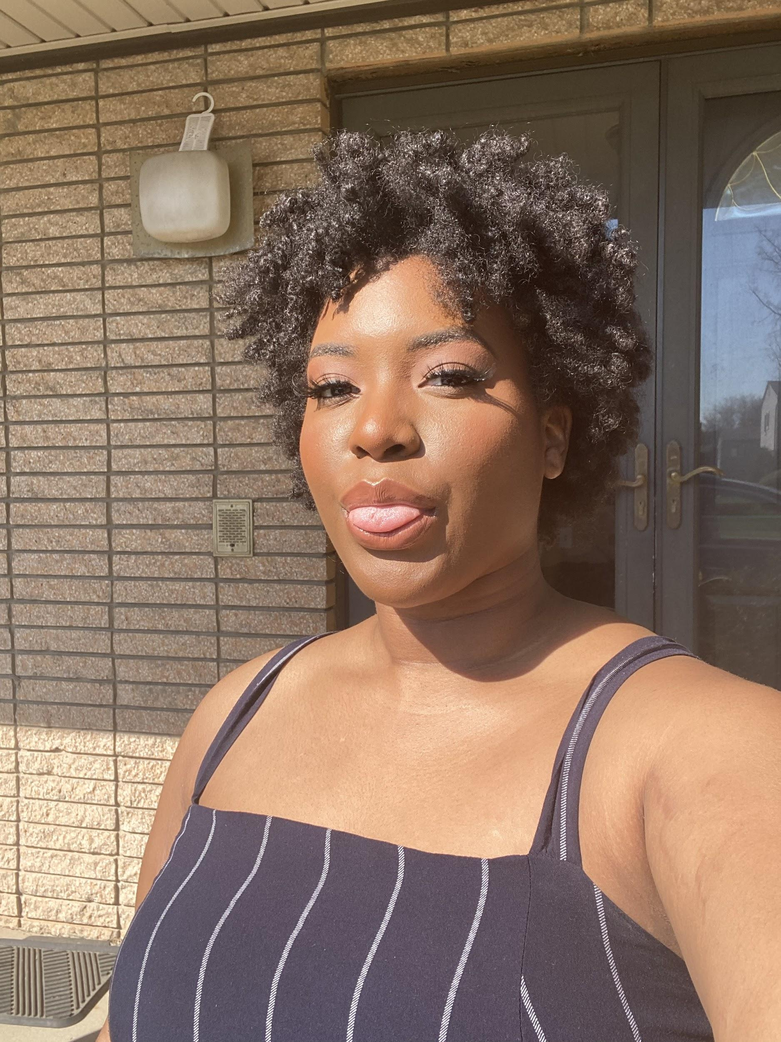
Lauren Henderson
Major: Psychology
Minors: Sociology Health & Medicine, Afroamerican and African Studies
I can play 4 instruments; clarinet, bass clarinet, tuba, and cello and I played tuba in my high school marching band

Slide 5
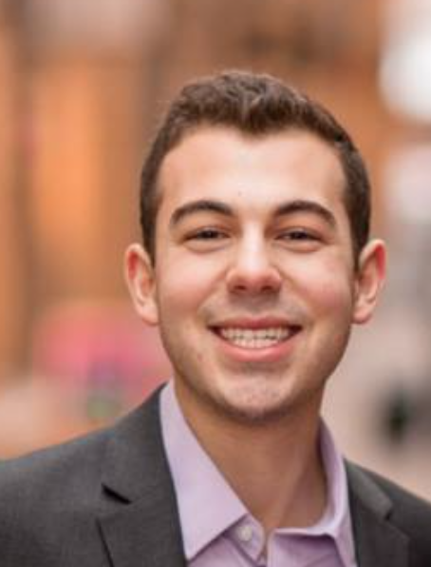
Benjamin Gerstein
Major: Public Policy
Minor: Afro-American and African Studies
Campus Involvement: Fmr. CSG President (2019-2020)
Overly optimistic Chicago sports fan

Slide 6
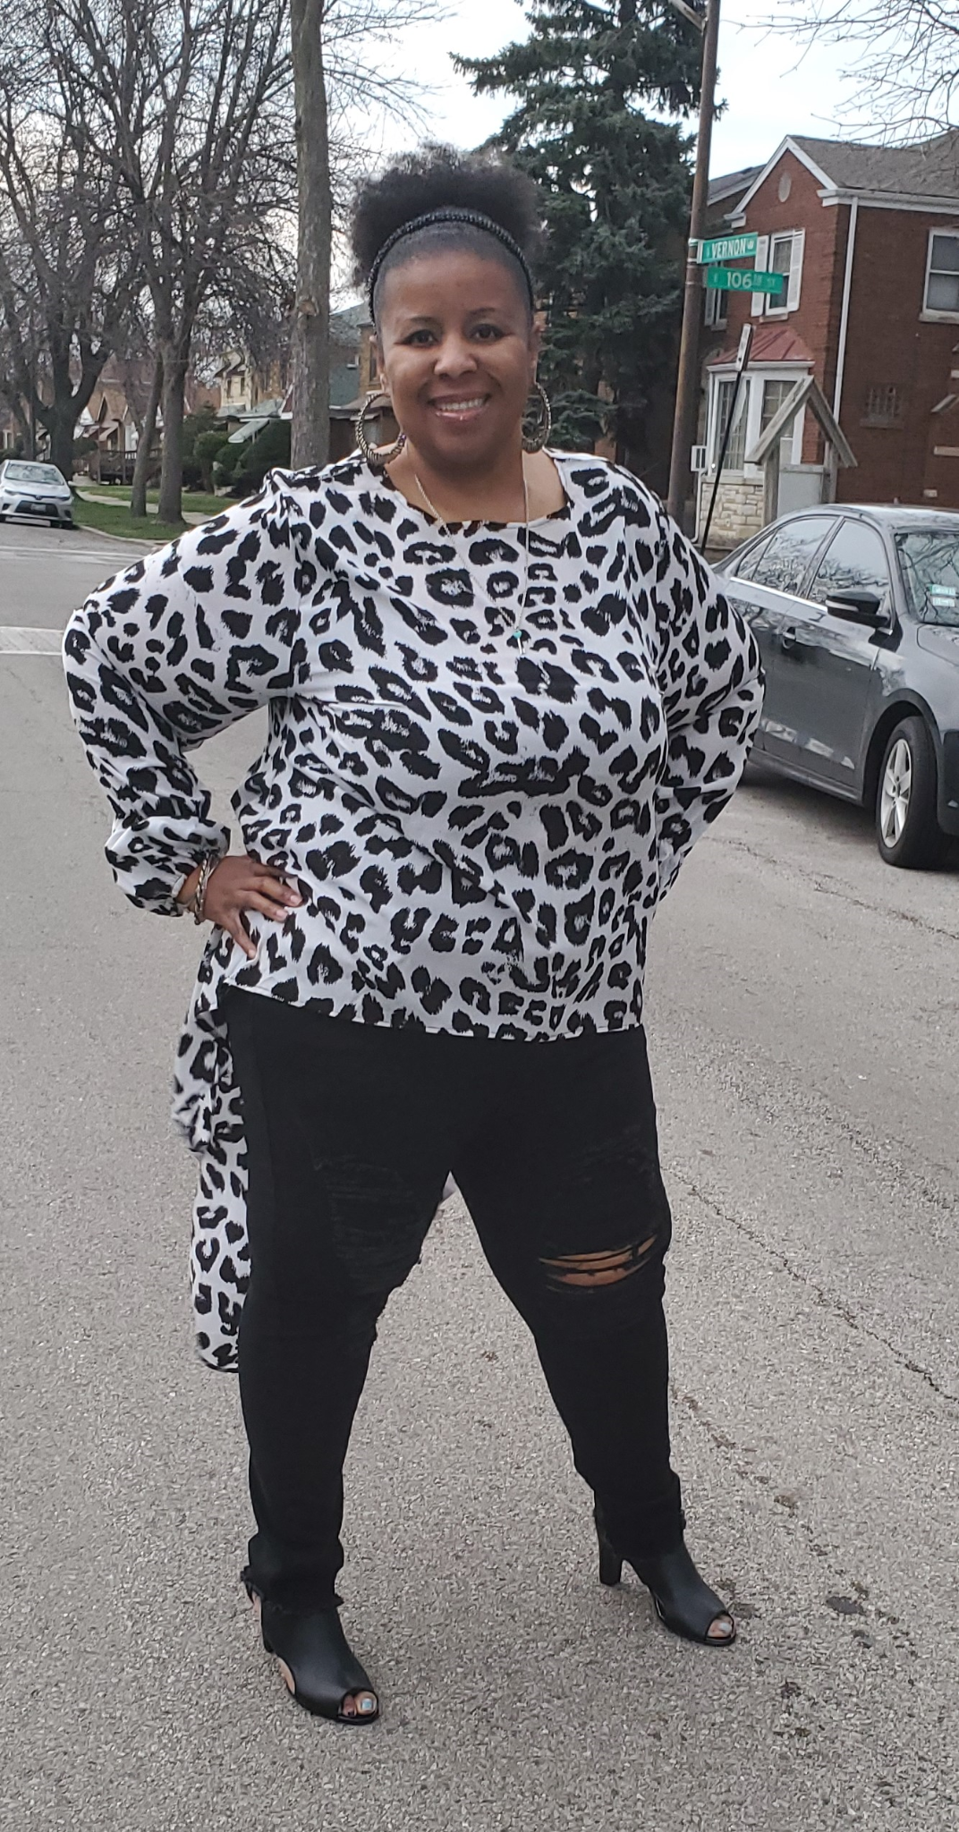
Chandra V Howard
Major: Afro-American & African Studies
Chicago (South side)
Member of Zeta Phi Beta Sorority, Incorporated
Mother of 2
Came back after 20 years to complete degree

Slide 7
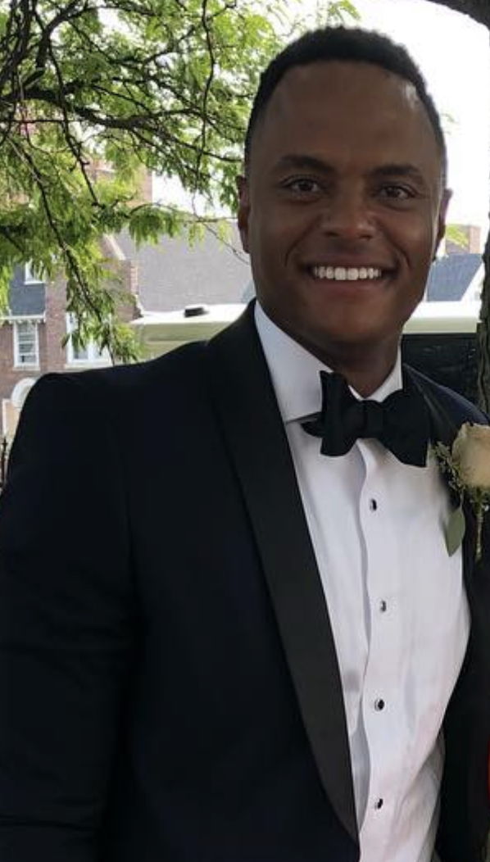
Keith D. Hazely II
Major: Political Science
Minor: Afro-American and African Studies
Metro Detroit native and returning student
Avid golfer

Slide 8
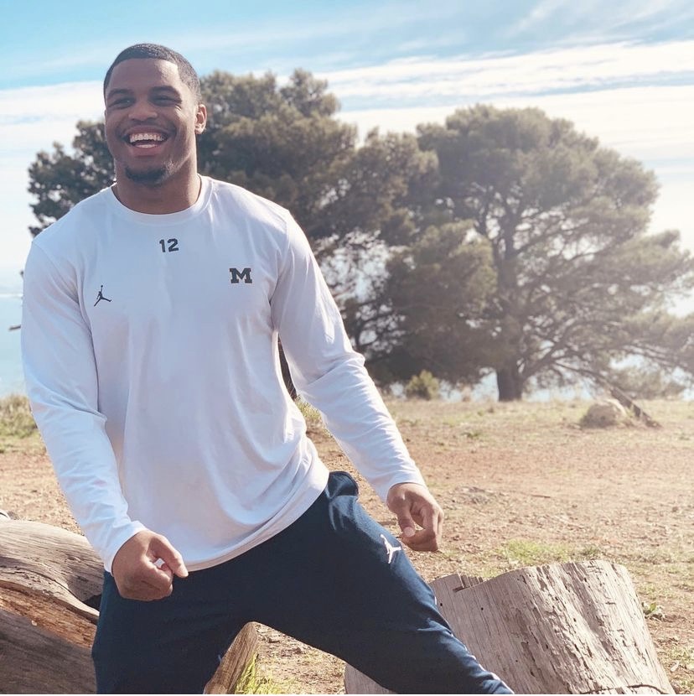
Joshua Ross
Major: Afro-American and African Studies
Born and raised in Southfield, Michigan
Younger Brother of a UM Grad
Student-Athlete and Captain here at MIchigan

Slide 9
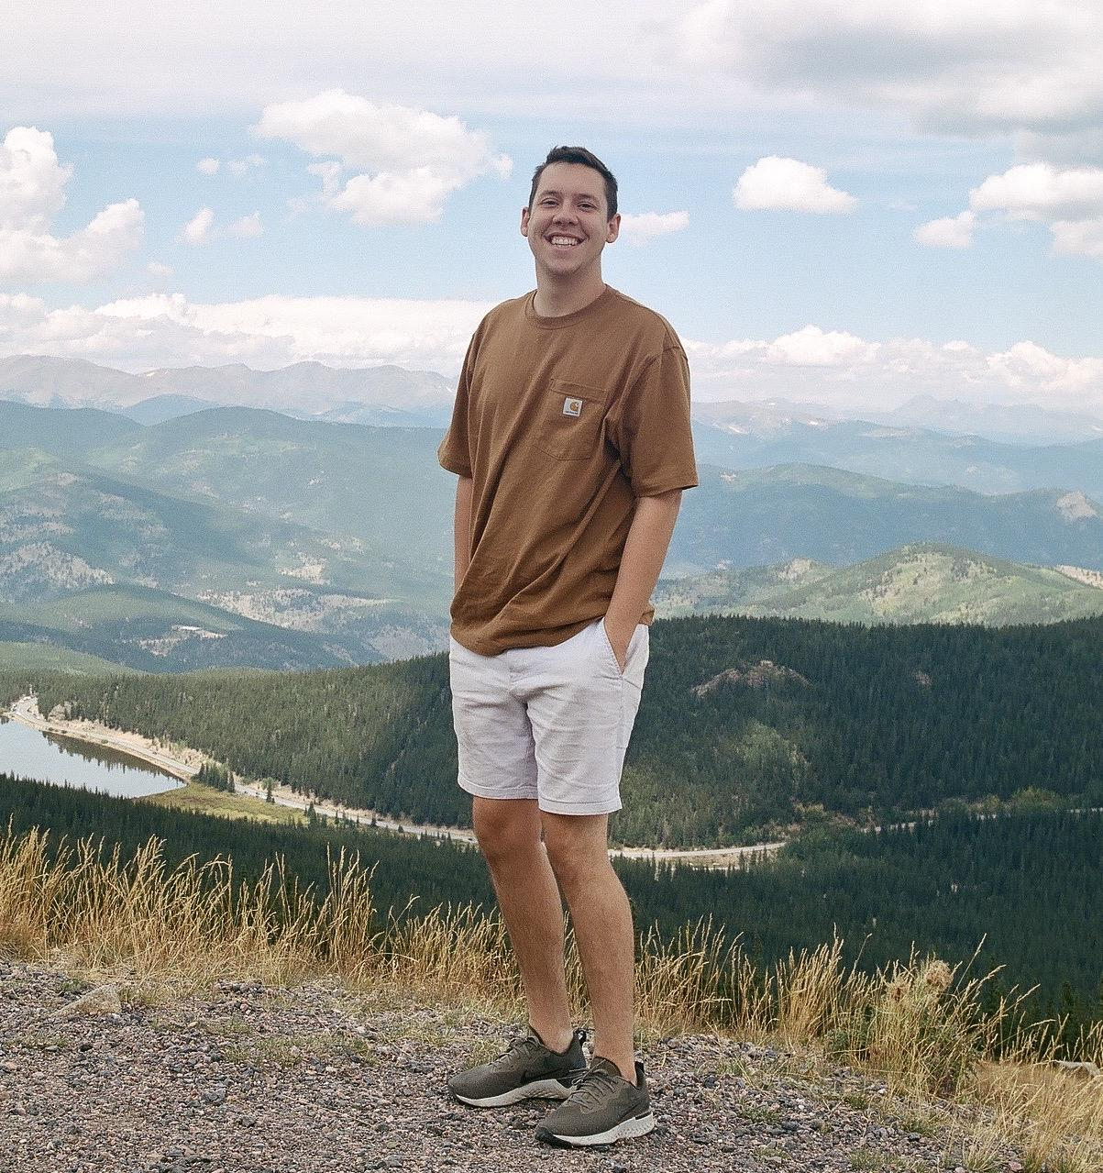
Brian Bradley
Majors:
  Afro-American and African Studies
  Program in the Environment
First Gen Student
Attending Harvard Graduate School of Design Fall 2021
  Master of Architecture

Slide 10
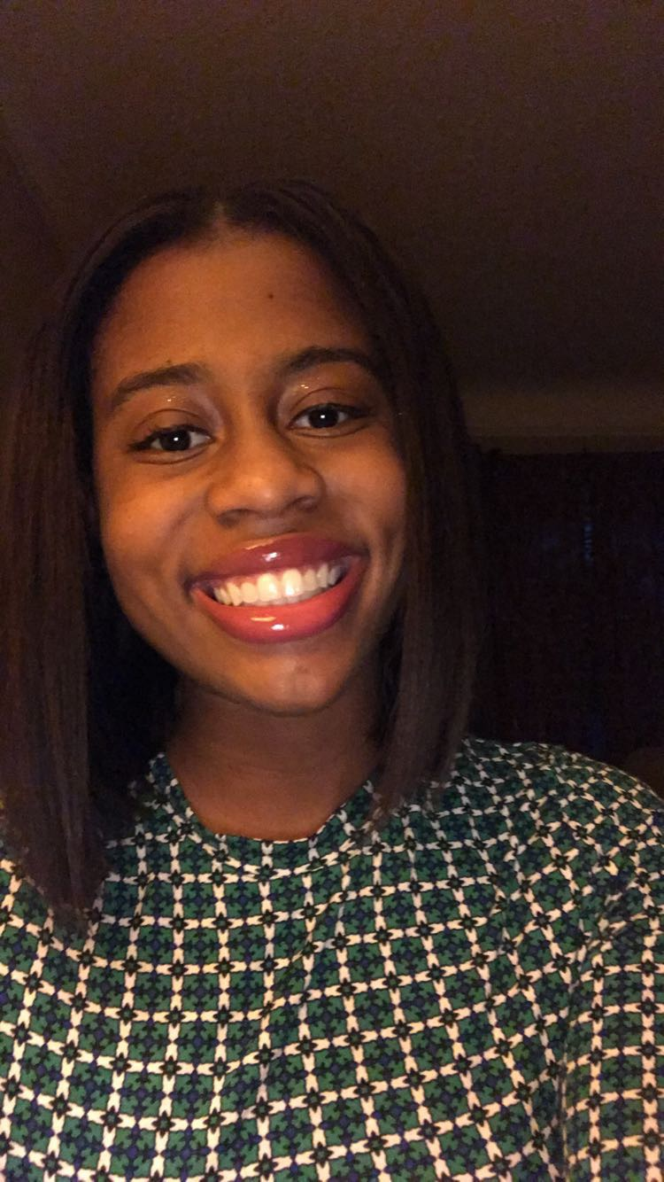
Christina Gleaton
Major: Cognitive Science and Philosophy
Minor: Afro-American and African Studies
Detroit Native
SIBS Participant Engagement Chair
I enjoy tennis, movies, and travel!

