Slide 1
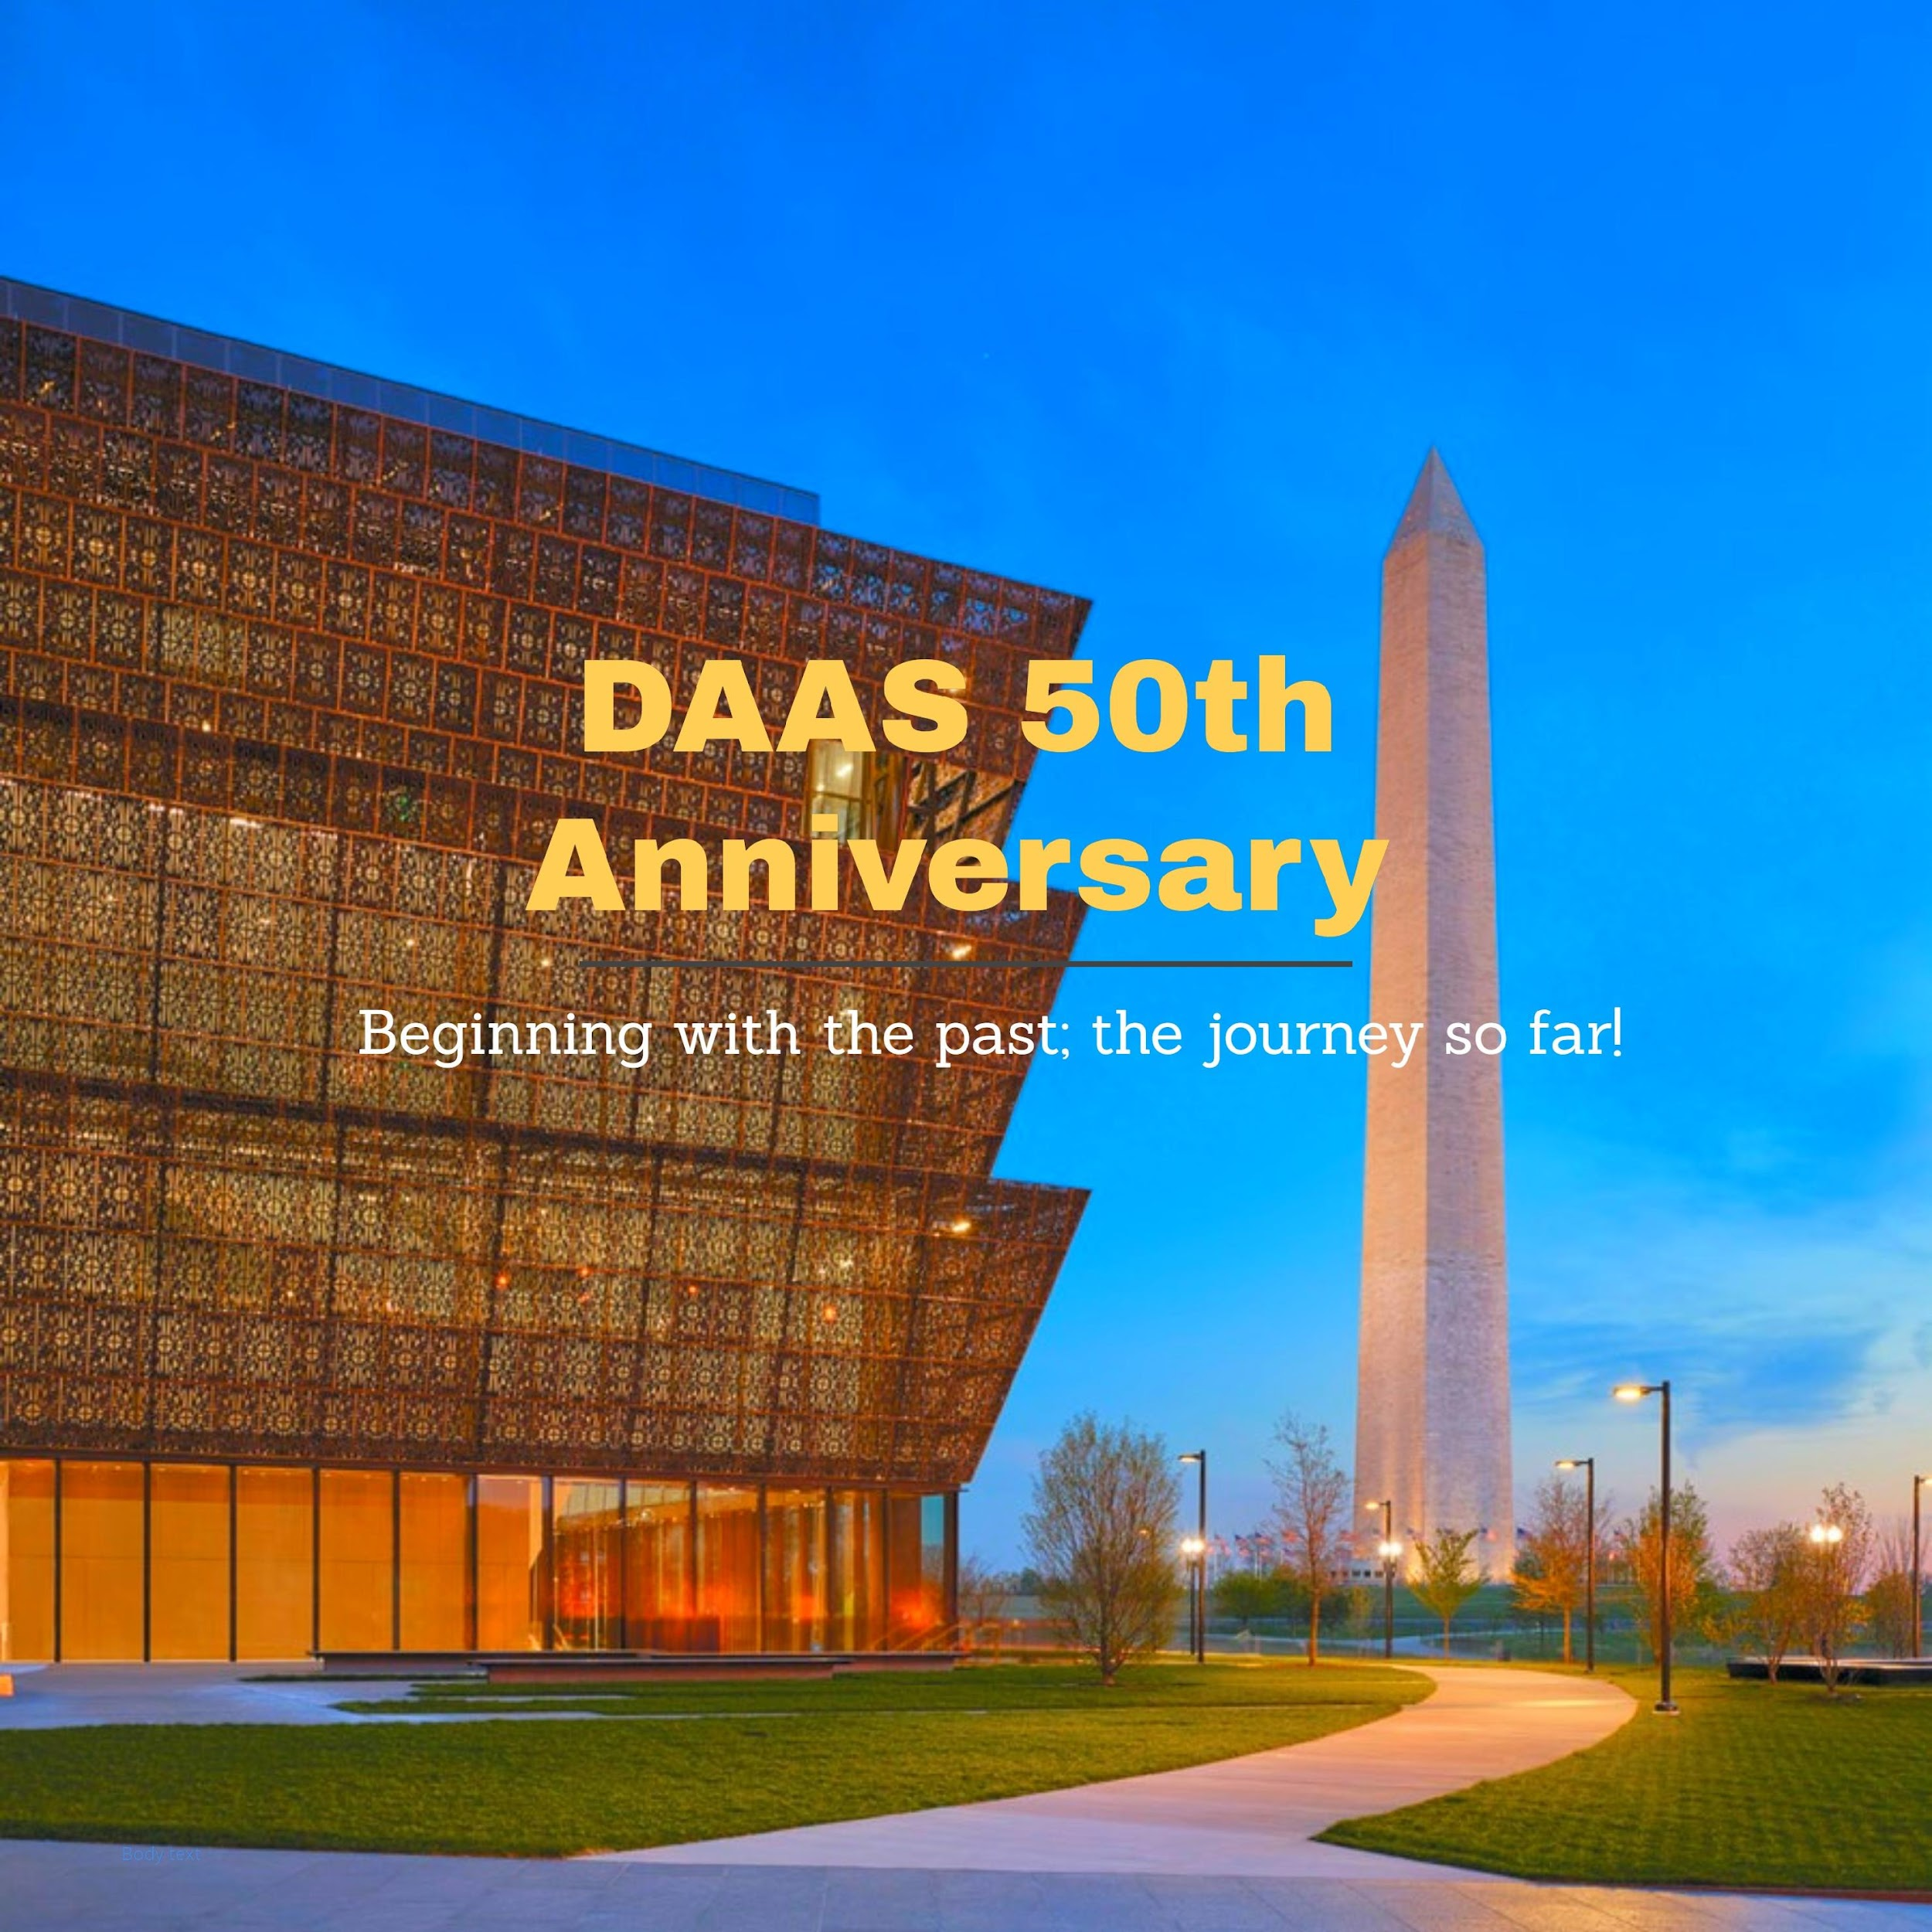
Department of Afroamerican and African Studies (DAAS) @ 50
A brief history of DAAS
In January 1970, representatives from different black student caucuses at the University of Michigan came together to form a coalition called Black Action Movement (BAM). In March 1970, BAM I strike fought for increased Black enrollment, recruitment of Black faculty, increase of supportive academic services for Black students enrolled at the University of Michigan, and demanded that the University create a full-fledged center for Afro-American Studies. The Center for Afroamerican and African Studies (CAAS) was established in the fall of 1970. Throughout its fifty-year history, the Center, which became a full-fledged academic department in 2011, has provided a rich variety of opportunities for learning about the continent of Africa, contrasting cultures and societies of African-descended people around the globe, and providing cultural resources for students of African heritage.

Slide 2
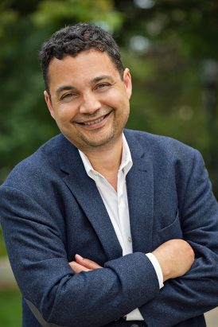
Meet Our Leader
MATTHEW COUNTRYMAN
Chair of DAAS; Associate Professor of History, American Culture
Professor Countryman is the Chair of DAAS, Associate Professor of History, and American Culture. His areas of research include African-American social movements; Race, postwar liberalism, and the American left; Public memory of the Civil Rights movement; and the social construction of race. Professor Countryman served as Faculty Director of the Arts of Citizenship Program, now called the Rackham Program in Public Scholarship, from 2007 to 2016.of American Culture

Slide 3
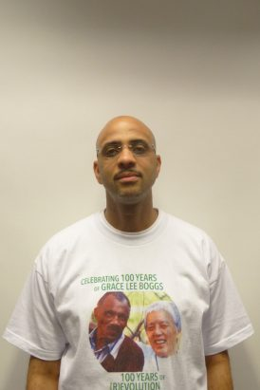
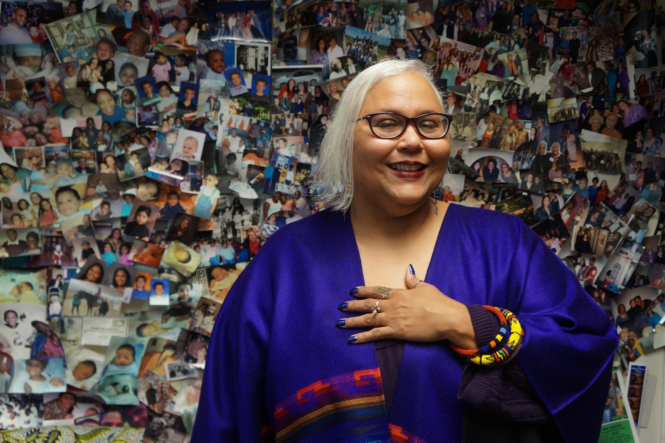
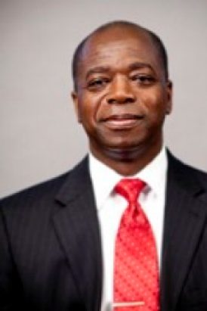
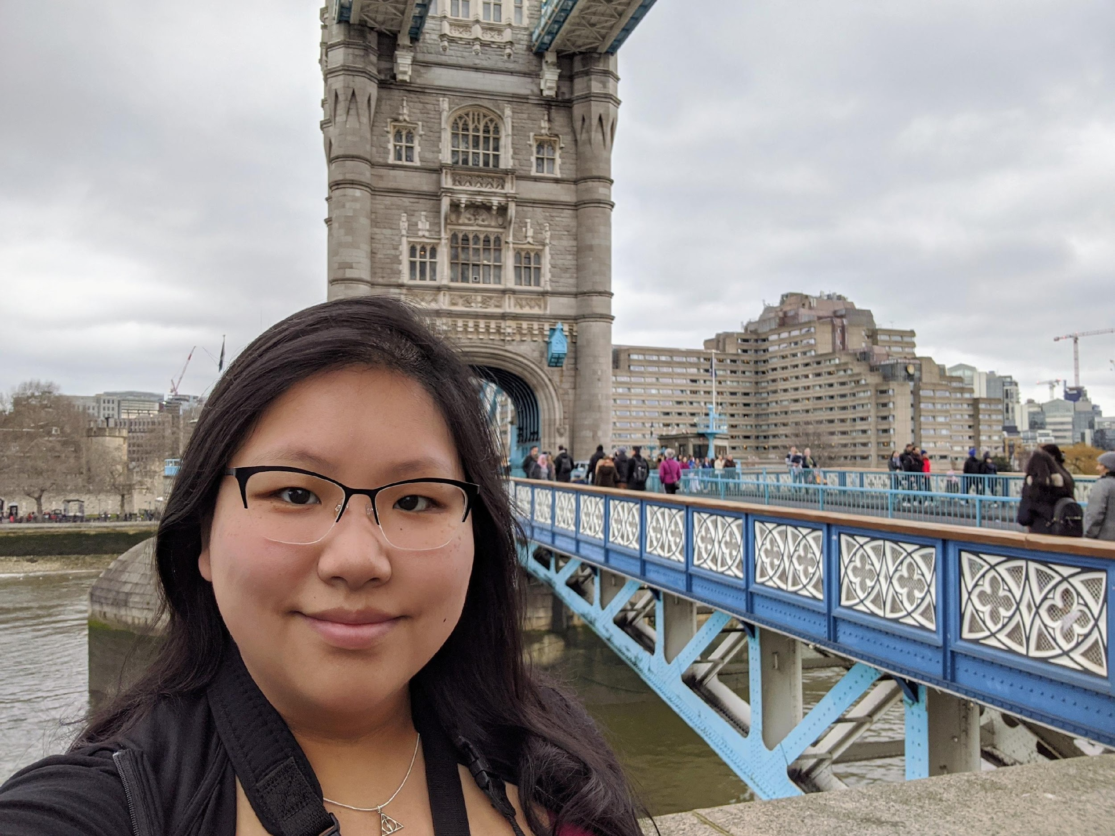
Meet Our Team
STEPHEN
WARD
ELIZABETH
JAMES
WAYNE
HIGH
ARIELLE
CHEN
DAAS@50
DAAS@50
DAAS@50
DAAS@50

Slide 4
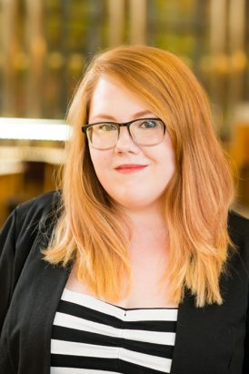
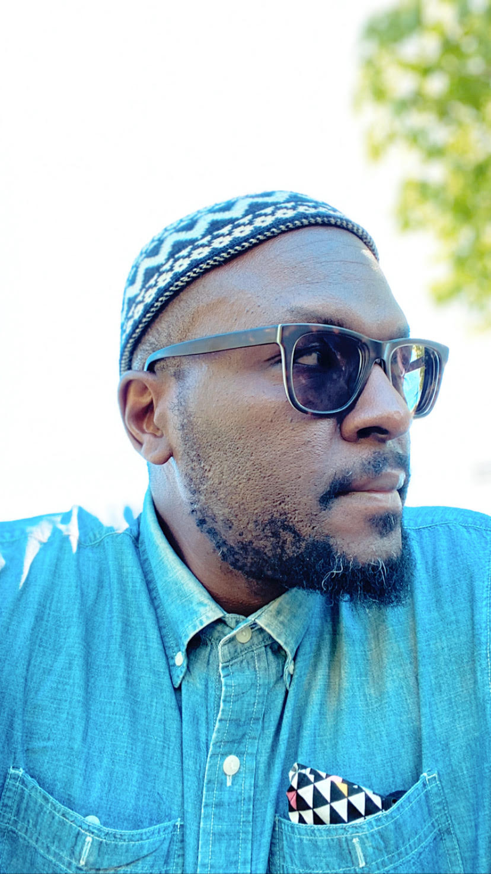
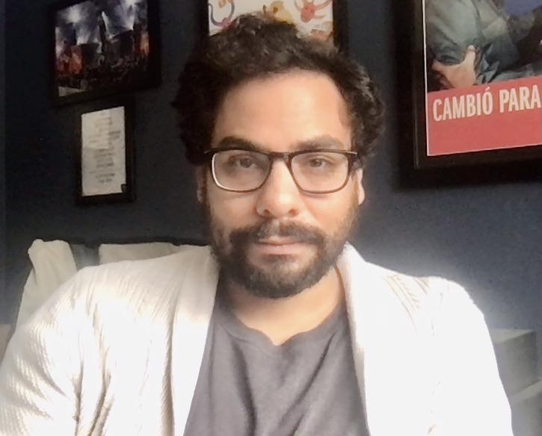
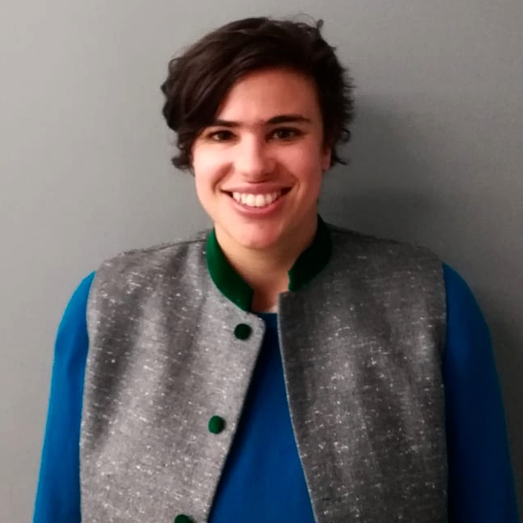
Meet Our Team
HELEN
GARBARINO
TAHIR
ABDULLAH
MATTHEW
STEHNEY
TARA
WEINBERG
DAAS@50
DAAS@50
DAAS@50
DAAS@50

Slide 5
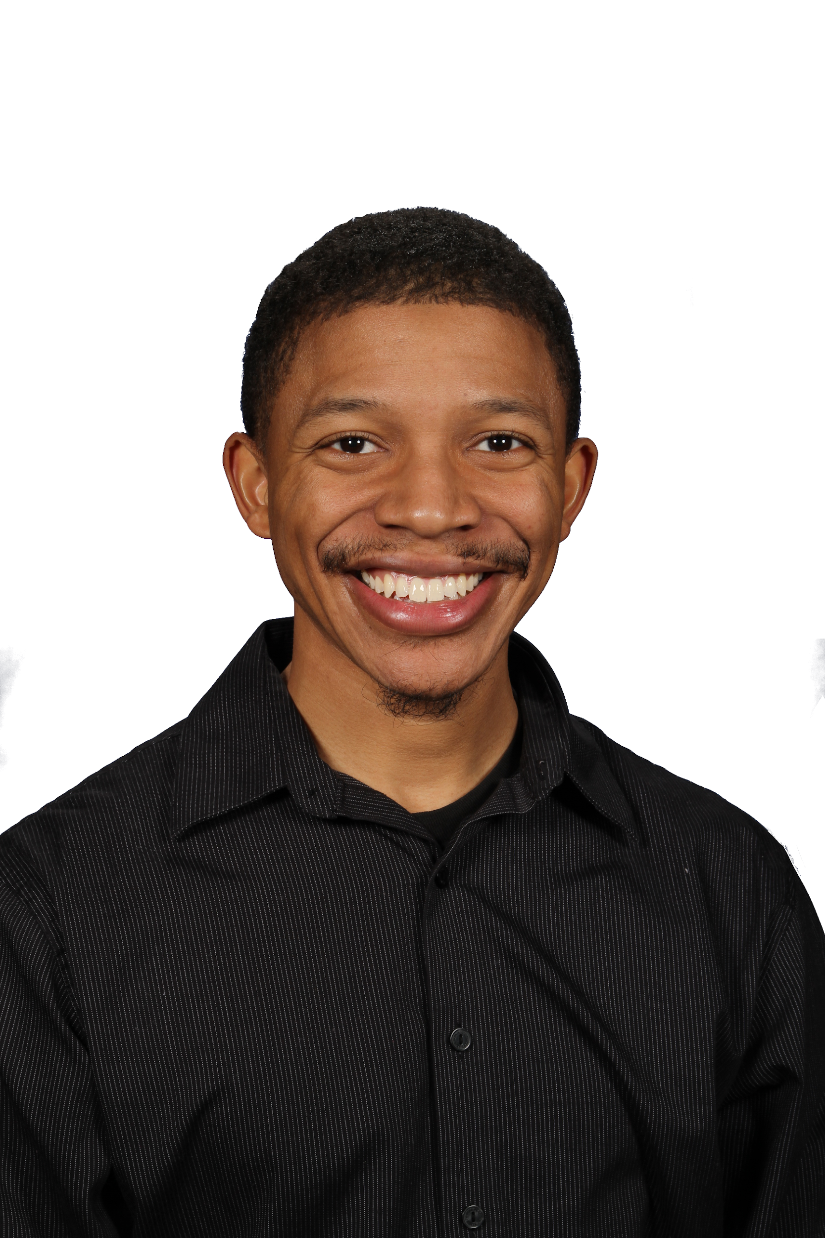
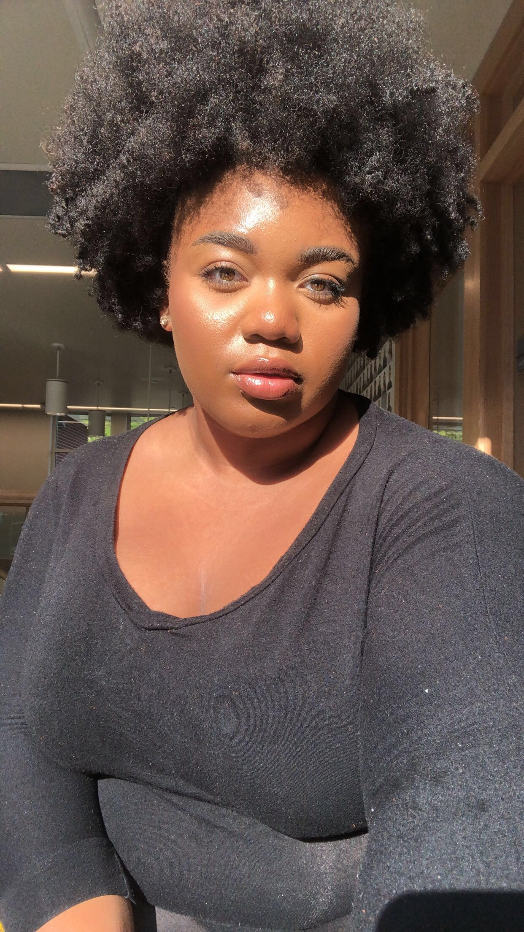
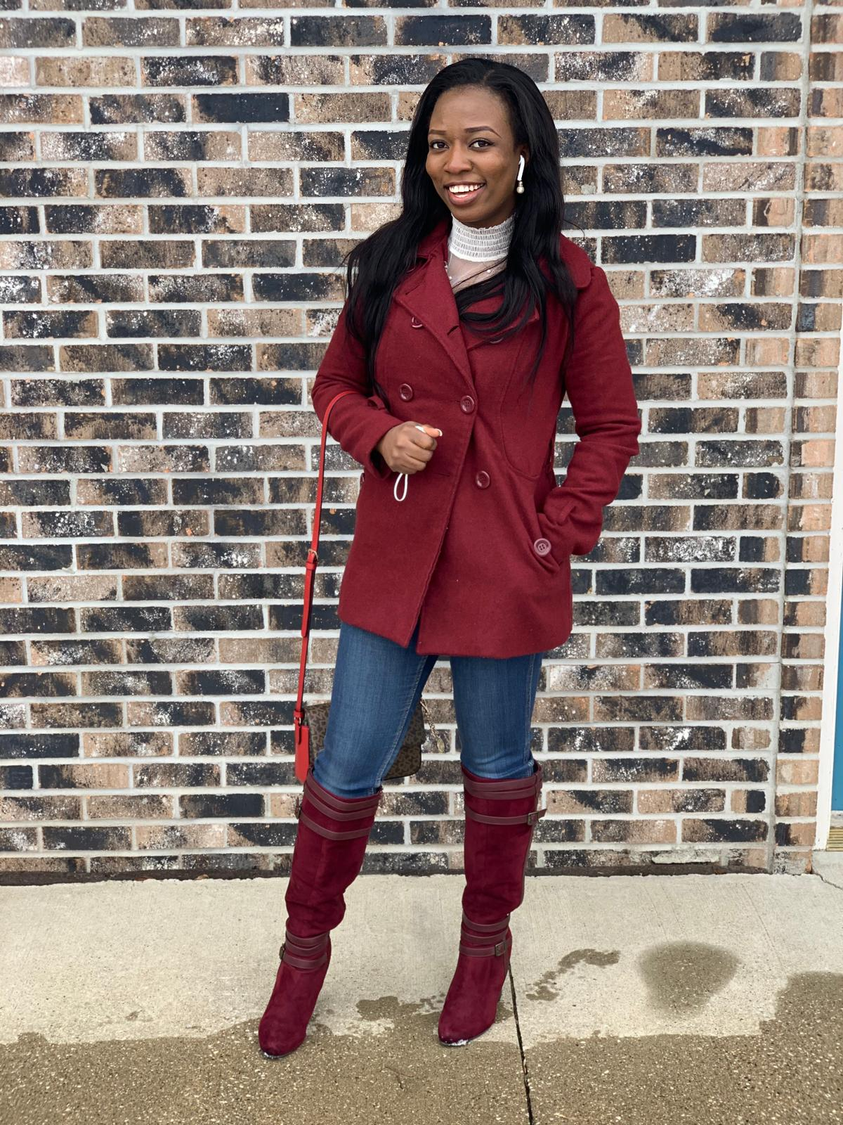
Meet Our Team
BYRON
MAXEY
ZOE
ALLEN
DOLAPO
RAJI
DAAS@50
DAAS@50
DAAS@50

Slide 6
Team Member
STEPHEN WARD
Director, Semester in Detroit; Associate Professor Residental College, DAAS
Stephen Ward is a historian who teaches in the RC Social Theory and Practice program (STP) as well as the Department of Afroamerican and African Studies (DAAS). His teaching and writing focus on two areas of recent American history. One is African American political thought and social movements, particularly the Black Power movement of the 1960s and 1970s. The other area is the evolution of cities since World War II, with an emphasis on grassroots activism and community-based approaches to urban redevelopment. Much of his work focuses on the city of Detroit. He is completing a dual-biography of two long-time Detroit activists, James and Grace Lee Boggs, and he is a board member of the James and Grace Lee Boggs Center to Nurture Community Leadership in Detroit.

Slide 7
Team Member
ELIZABETH JAMES
Administrative/Project Coordinator
Elizabeth James is a native Detroiter who serves as the Program Manager in the Department of Afroamerican and African Studies (DAAS) at the University of Michigan. She holds Bachelor’s degrees in Communications and History of Art as well as a Master’s of Arts in Journalism and post-graduate work in the School of Information from the University of Michigan and from Wayne State University, a Master’s of Science in Library Science. Elizabeth has received many honors for her service and dedication to DAAS and the outreach programs she organizes such as the Cornerstone Award for Black Celebratory, the Ginsberg Award for Service and Social Activism, the Distinguished Diversity Leader Award, Advisor of the Year and the Harold D. Johnson Diversity Service Award. However, she most cherishes serving as an adviser to U-M student organizations such as the Black Student Union and the National Council of Negro Women, and serving as a doula in birthing children, ideas and dreams as well as volunteering for the organ and tissue donation group, Wolverines for Life for transplant recipients like herself. As a third-generation storyteller, she loves helping others to find their voice and express themselves.

Slide 8
Team Member
WAYNE HIGH
Chief Administrator
Wayne joined the Department of Afroamerican and African Studies as Chief Administrator in September 2010. In this role, he acts as a strategic partner to the Department Chair and is responsible for the management of non-instructional operations which include budget and finance management (planning and execution); human resources (faculty and staff) appointments; facility issues, and supervision of the office staff. He serves as a liaison between the department and the College; interprets University and College policies; and develops strategic plans with the Chair and staff.

Slide 9
Team Member
ARIELLE CHEN
Administrative/Project Coordinator
Arielle joined the Department of Afroamerican and African Studies as Administrative Coordinator/Project Coordinator in June 2018. Arielle’s responsibilities include managing office operations and communications, serving as the liaison for the DAAS Graduate Certificate Program, collaborating with the GalleryDAAS Director as Gallery Manager, and providing visiting scholar, event, and faculty/staff support. Outside of work, she spends most of her time engaged in social justice efforts and creative projects.

Slide 10
Team Member
HELEN GABARINO
Communications Coordinator
Helen provides communication support to the departments of Anthropology and Afroamerican and African. For each unit, Helen provides assistance in the creation and development of promotional materials, event support, web maintenance, news writing, photography, and social media management.

Slide 11
Team Member
TAHIR ABDULLAH
Doctoral Candidate at the Department of History
Tahir Abdullah is from Oakland, California. He is currently a doctoral student in history at the University of Michigan and his research examines state formation and warfare in 19th century West Africa and the subsequent enslavement and revolts of African people throughout the Atlantic during that period.

Slide 12
Team Member
MATTHEW STEHNEY
Doctoral Candidate at the Department of History
Matthew Carlos Stehney is a doctoral student in history at the University of Michigan. He studies the history of capitalism in the US, the history of Black capitalism in the US, and traditions of Black economic thought. Matthew Carlos has been working with the DAAS team since the summer of 2020

Slide 13
Team Member
TARA WEINBERG
Doctoral candidate and GSRA at DAAS
Tara Weinberg is a PhD candidate in the Department of History. Tara is interested in issues of law, activism, political economy and gender in 20th century South Africa. Her current research examines traditions of political thought around property, which black farmers developed and implemented during colonialism and apartheid. Tara previously worked as a researcher at the United African Organization in Chicago, which focused on issues facing African immigrants and refugees in the US, as well as building bridges towards Pan Africanism. She also worked on South Africa's contemporary 'Land Restitution' program at the University of Cape Town -- work that bridged scholarship and activism.

Slide 14
Team Member
BRYON MAXEY
Partnership Manager at the University of Michigan, Center for Academic Innovation
Bryon Maxey is an educator and interdisciplinary researcher of Islam and premodern Africa. Bryon is also an experienced facilitator and co-creator of online learning and digital humanities projects. He is a PhD student in Religion at the University of Toronto and a Partnership Manager at the University of Michigan Center for Academic Innovation.

Slide 15
Team Member
ZOE ALLEN
DAAS Alumna
Zoe Allen is a first-year law student at Chicago-Kent College of Law and a recent DAAS alumna. She graduated from the University of Michigan in Spring 2020 with a BA in AfroAmerican and African Studies. While attending Michigan, Zoe served on the executive board of the Black Student Union as their Political Action and Concerns Chair. She also worked in GalleryDAAS as an Entrance Monitor. Zoe hopes to pursue a career in criminal justice or as a civil rights attorney. Outside of work and school, Zoe is an avid Sims 4 player and produces makeup content.

Slide 16
Team Member
DOLAPO RAJI
Graduate Student at School of Information; Research Assistant at DAAS
Dolapo Raji is a second year MHI (Masters of Health Informatics) student at the School of Information and a Dow Fellow 2020. Prior to moving to Ann Arbor, she graduated from Central Michigan University with a Masters degree in Public Health where she was launched into research analysis; honed her research skills in quantitative and qualitative analysis; and published three article papers. She is interested in health-related research and the interpretation of data to improve the processes and quality of healthcare services as it relates to health and well-being of individuals particularly under-served populations.

Slide 17

Thank You.
DAAS@50 TEAM

